Slide 1


SOFTWARE REQUIREMENT ANALYSIS

Slide 2

CONTENTS
01 | SOFTWARE REQUIREMENTS | 3
02 | REQUIREMENT ENGINEERING | 14
03 | REQUIREMENT SPECIFICATION (TEMPLATE + CASE STUDY) | 45
04 | ANALYSIS MODEL | 55
05 | STRUCTURED ANALYSIS MODEL | 66
06 | OBJECT ORIENTED ANALYSIS MODEL | 87

Slide 3
Software Requirements

Slide 4
Why project fails?
Many projects fail:
because we start implementing the system:
without determining whether we are building what the customer really wants.

Slide 5
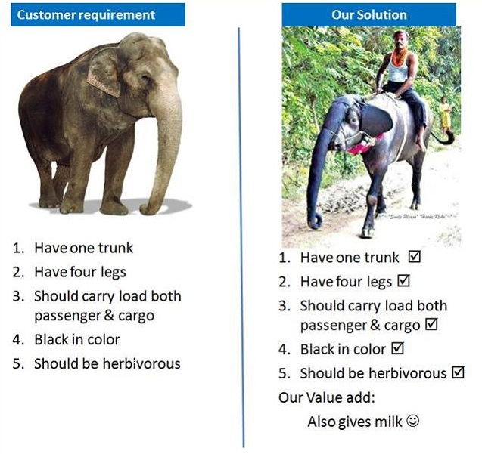
An example

Slide 6
Understand and specifying requirements
A problem of scale
For small scale: understand and specifying requirements is easy
For large scale: very hard; probably the hardest, most problematic and error prone
The requirements task:
Input: User needs in minds of people
Output: precise statement of what the future system will do

Slide 7
Challenges
Identifying and specifying requirements
Necessarily involves people interaction
Cannot be automated

Slide 8
Background (1/2)
What is a Requirement?
A condition or capability that must be possessed by a system (IEEE)
What is the work product of the Req. phase ?
A software requirements specification (SRS) document
What is an SRS ?
A complete specification of what the proposed system should do!

Slide 9
Background (2/2)
Requirements understanding is hard
Visualizing a future system is difficult
Capability of the future system not clear, hence needs not clear
Requirements change with time
…
Essential to do a proper analysis and specification of requirements

Slide 10
Purpose of SRS document
SRS establishes basis of agreement between the user and the supplier.
Users needs have to be satisfied, but user may not understand software
Developers will develop the system, but may not know about problem domain
SRS is
the medium to bridge the communications gap, and
specifies user needs in a manner both can understand

Slide 11
Need for SRS (1/3)
Helps user understand his needs.
users do not always know their needs
must analyze and understand the potential
The requirement process helps clarify needs
SRS provides a reference for validation of the final product
Clear understanding about what is expected.
Validation - “SW satisfies the SRS”

Slide 12
Need for SRS (2/3)
High quality SRS essential for high Quality SW
Requirement errors get manifested in final SW
To satisfy the quality objective, must begin with high quality SRS
Requirements defects cause later problems
In one study, 25% of all defects found after user testing

Slide 13
Need for SRS (3/3)
Good SRS reduces the development cost
SRS errors are expensive to fix later
Req. changes can cost a lot (up to 40%)
Good SRS can minimize changes and errors
Substantial savings; extra effort spent during req. saves multiple times that effort
An Example
Cost of fixing errors in req. , design, coding, acceptance testing and operation are 2, 5, 15, 50, 150 person-months

Slide 14
Requirement Engineering

Slide 15
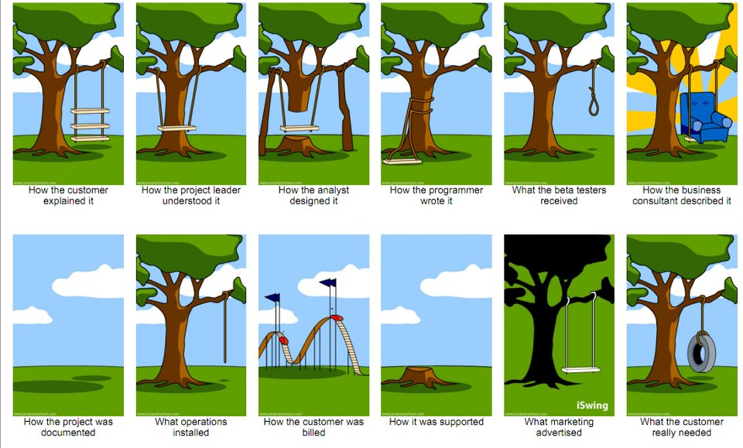
The Problems with our Requirements Practices (1/3)

Slide 16
The Problems with our Requirements Practices (2/3)
We have trouble understanding the requirements that we do acquire from the customer
We often record requirements in a disorganized manner
We spend far too little time verifying what we do record
We allow change to control us, rather than establishing mechanisms to control change
Most importantly, we fail to establish a solid foundation for the system or software that the user wants built

Slide 17
The Problems with our Requirements Practices (3/3)
Many software developers argue that
Building software is so compelling that we want to jump right in (before having a clear understanding of what is needed)
Things will become clear as we build the software
Project stakeholders will be able to better understand what they need only after examining early iterations of the software
Things change so rapidly that requirements engineering is a waste of time
The bottom line is producing a working program and that all else is secondary

Slide 18
A Solution: Requirements Engineering
The process of establishing the services that the customer requires from a system and the constraints under which it operates and is developed
Begins during the communication activity and continues into the modeling activity
Builds a bridge from the system requirements into software design and construction
Allows the requirements engineer to examine
the context of the software work to be performed
the specific needs that design and construction must address
the priorities that guide the order in which work is to be completed
the information, function, and behavior that will have a profound impact on he resultant design

Slide 19
Requirements Engineering Tasks
Seven distinct tasks
Inception
Elicitation
Elaboration
Negotiation
Specification
Validation
Requirements Management
Some of these tasks may occur in parallel and all are adapted to the needs of the project
All strive to define what the customer wants
All serve to establish a solid foundation for the design and construction of the software

Slide 20
Inception Task
During inception, the requirements engineer asks a set of questions to establish…
A basic understanding of the problem
The people who want a solution
The nature of the solution that is desired
The effectiveness of preliminary communication and collaboration between the customer and the developer
Through these questions, the requirements engineer needs to…
Identify the stakeholders
Recognize multiple viewpoints
Work toward collaboration
Break the ice and initiate the communication

Slide 21
Inception Task
First set of questions | Next set of questions | Final set of questions
These questions focus on the customer, other stakeholders, the overall goals, and the benefits | These questions enable the requirements engineer to gain a better understanding of the problem and allow the customer to voice his or her perceptions about a solution | These questions focus on the effectiveness of the communication activity itself
• Who is behind the request for this work? • Who will use the solution? • What will be the economic benefit of a successful solution? • Is there another source for the solution that you need? | • How would you characterize "good" output that would be generated by a successful solution? • What problem(s) will this solution address? • Can you show me (or describe) the business environment in which the solution will be used? • Will special performance issues or constraints affect the way the solution is approached? | • Are you the right person to answer these questions? Are your answers "official"? • Are my questions relevant to the problem that you have? • Am I asking too many questions? • Can anyone else provide additional information? • Should I be asking you anything else?

Slide 22
Elicitation Task
Eliciting requirements is difficult because of
Problems of scope in identifying the boundaries of the system or specifying too much technical detail rather than overall system objectives
Problems of understanding what is wanted, what the problem domain is, and what the computing environment can handle (Information that is believed to be "obvious" is often omitted)
Problems of volatility because the requirements change over time
Elicitation may be accomplished through two activities
Collaborative requirements gathering
Quality function deployment

Slide 23
Elaboration Task
During elaboration, the software engineer takes the information obtained during inception and elicitation and begins to expand and refine it
Elaboration focuses on developing a refined technical model of software functions, features, and constraints
It is an analysis modeling task
Use cases are developed
Domain classes are identified along with their attributes and relationships
State machine diagrams are used to capture the life on an object
ERD, Data Flow Diagram, CFD are developed
The end result is an analysis model that defines the functional, informational, and behavioral domains of the problem

Slide 24
Analysis Model
(Will be covered from slide- 55)

Slide 25
Negotiation Task
During negotiation, the software engineer reconciles the conflicts between what the customer wants and what can be achieved given limited business resources
Requirements are ranked (i.e., prioritized) by the customers, users, and other stakeholders
Risks associated with each requirement are identified and analyzed
Rough guesses of development effort are made and used to assess the impact of each requirement on project cost and delivery time
Using an iterative approach, requirements are eliminated, combined and/or modified so that each party achieves some measure of satisfaction

Slide 26
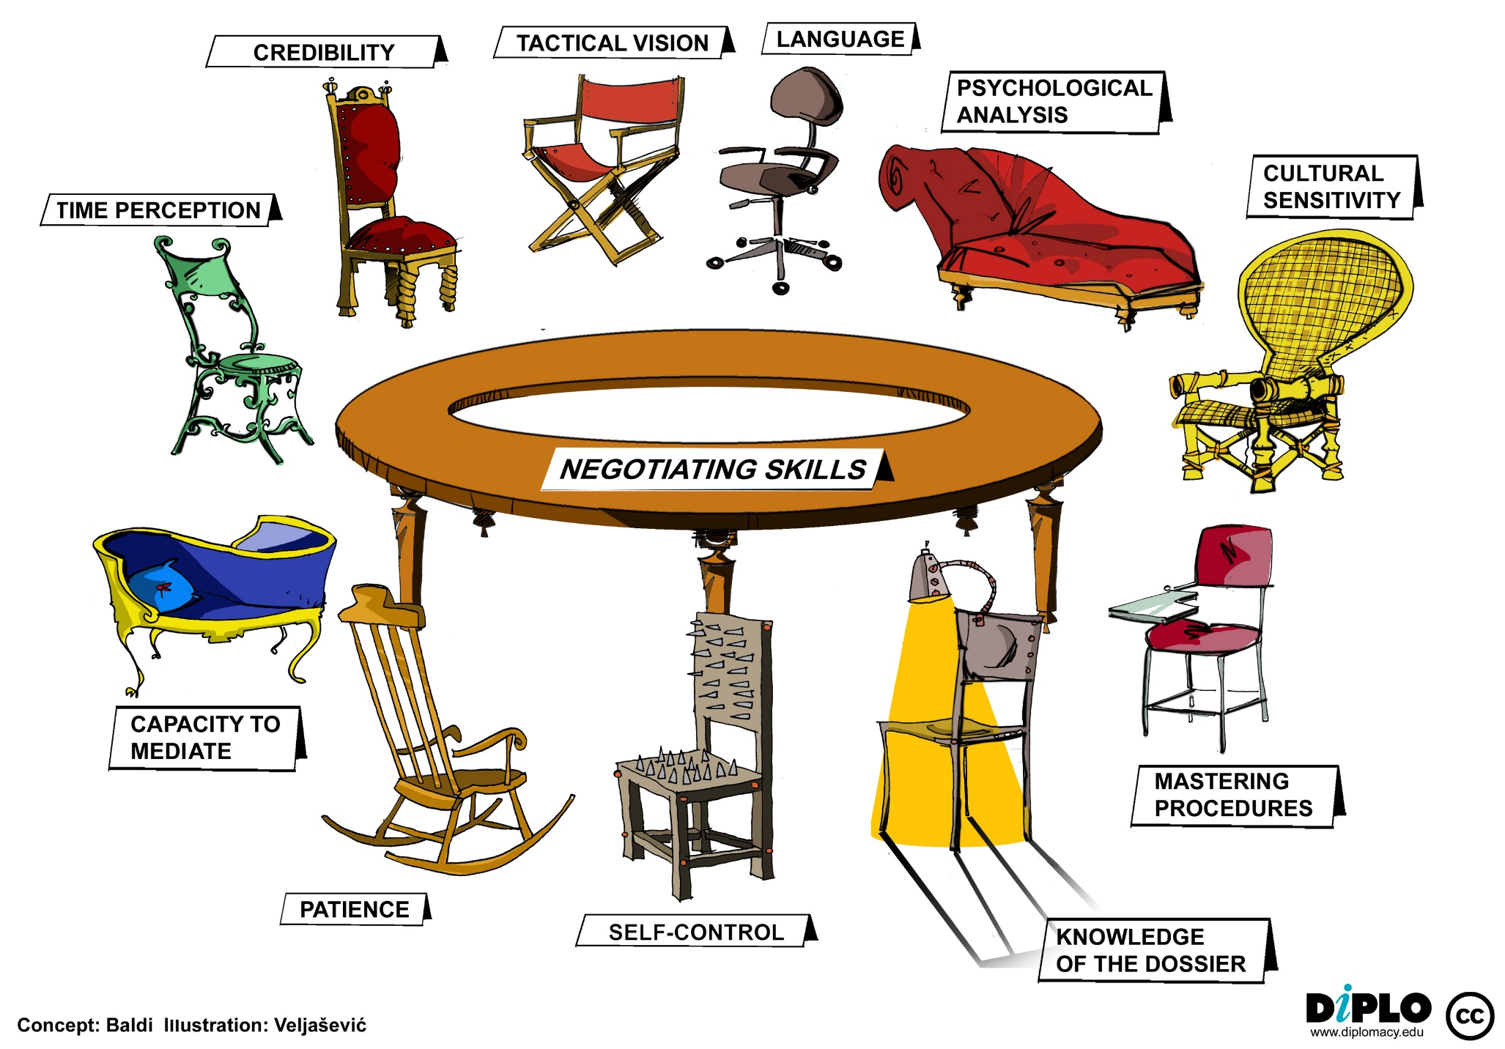
Negotiation skills

Slide 27
5. Requirement specification
Final output of requirements task is the SRS
Why are DFDs, OO models, etc not SRS ?
SRS focuses on external behavior, while modeling focuses on problem structure
UI etc. not modeled, but have to be in SRS
Error handling, constraints etc. also needed in SRS
Transition from analysis to specification is not straight forward
Knowledge about the system acquired in analysis used in specification

Slide 28
5. Characteristics of an SRS
Correct
Complete
Unambiguous
Consistent
Verifiable
Traceable
Modifiable
Ranked for importance and/or stability

Slide 29
5. Characteristics
Correctness
Each requirement accurately represents some desired feature in the final system
Completeness
All desired features/characteristics specified
Hardest to satisfy
Completeness and correctness strongly related
Unambiguous
Each req has exactly one meaning
Without this errors will creep in
Important as natural languages often used

Slide 30
5. Characteristics
Verifiability
There must exist a cost effective way of checking if SW satisfies requirements
Consistent
Two requirements don’t contradict each other
Traceable
The origin of the req, and how the req relates to software elements can be determined
Ranked for importance/stability
Needed for prioritizing in construction
To reduce risks due to changing requirements

Slide 31
5. Components of an SRS
What should an SRS contain ?
Clarifying this will help ensure completeness
An SRS must specify requirements on
External interfaces
Functionality
Performance
Design constraints
System attributes

Slide 32
5. External Interface
All interactions of the software with people, hardware, and SW
User interface most important
General requirements of “friendliness” should be avoided
These should also be verifiable

Slide 33
5. Functional requirements
Heart of the SRS document; this forms the bulk of the specs
Specifies all the functionality that the system should support
Outputs for the given inputs and the relationship between them
All operations the system is to do
Must specify behavior for invalid inputs too

Slide 34
5. Performance Requirements
All the performance constraints on the software system
Generally on response time , throughput etc => dynamic
Capacity requirements => static
Must be in measurable terms (verifiability)
E.g. response time should be <1sec in 99% of the time

Slide 35
5. Design Constraints
Factors in the client environment that restrict the choices
Some such restrictions
Standard compliance and compatibility with other systems
Hardware Limitations

Slide 36
5. System attributes
The requirements in this section specify the
Required reliability
Availability
Security and maintainability of the software system.

Slide 37
5. Specification Language
Language should support desired characteristics of the SRS
Formal languages are precise and unambiguous but hard
Natural languages mostly used, with some structure for the document
Formal languages used for special features or in highly critical systems

Slide 38
5. Structure of an SRS
1. Introduction
1.1 Purpose
1.2 Scope
1.3 Definitions
1.4 References
1.5 Overview
2. General Description
2.1 Product Perspective
2.2 Product Functions
2.3 User Characteristics
2.4 General Constraints
2.5 Assumptions and Dependencies

Slide 39
5. Structure of an SRS
3. Specific Requirements
3.1 Functional Requirements
3.1.1 Func Req 1
3.1.1.1 Introduction
3.1.1.2 Inputs
3.1.1.3 Processing
3.1.1.4 Outputs
3.1.2 Func Req 2
…
3.2 External Interface Requirements
3.2.1 User Interface
3.2.2 Hardware Interfaces
3.2.3 Software Interfaces
3.2.4 Communication Interfaces
3.3 Performance Requirements
3.4 Design Constraints
3.4.1 Standards Compliance
3.4.2 Hardware Limitations
3.5 Software System Attributes
3.5.1 Security
3.5.2 Maintainability
3.6 Other Requirements
3.6.1 Database

Slide 40
Requirement Specification
(Template and Case Study)

Slide 42
6. Validation Task
During validation, the work products produced as a result of requirements engineering are assessed for quality
The specification is examined to ensure that
all software requirements have been stated unambiguously
inconsistencies, omissions, and errors have been detected and corrected
the work products conform to the standards established for the process, the project, and the product
The formal technical review serves as the primary requirements validation mechanism
Members include software engineers, customers, users, and other stakeholders
Do any requirements conflict with other requirements?
Is each requirement achievable in the technical environment that will house the system or product?
Is each requirement testable, once implemented?
Approaches: Demonstration, actual test, analysis, or inspection
Does the requirements model properly reflect the information, function, and behavior of the system to be built?
Has the requirements model been “partitioned” in a way that exposes progressively more detailed information about the system?

Slide 43
7. Requirements Management Task
During requirements management, the project team performs a set of activities to identify, control, and track requirements and changes to the requirements at any time as the project proceeds
Each requirement is assigned a unique identifier
The requirements are then placed into one or more traceability tables
These tables may be stored in a database that relate features, sources, dependencies, subsystems, and interfaces to the requirements
A requirements traceability table is also placed at the end of the software requirements specification

Slide 44
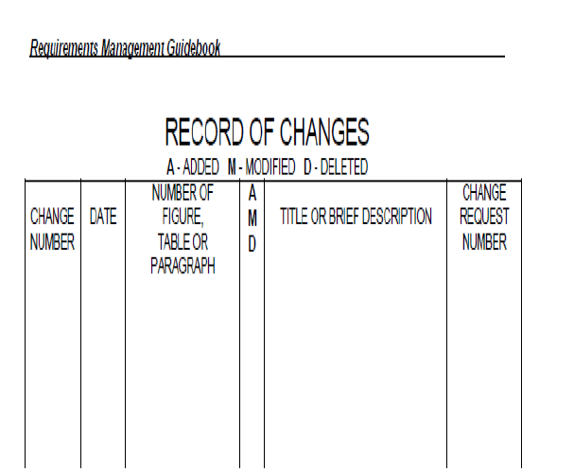
Sample requirement management table

Slide 45
SRS users

Slide 46
Requirement engineering practices
Initiation
Elicitation
Elaboration
Negotiation
needs
Process is not linear, it is iterative and parallel
Overlap between phases - some parts may be analyzed and specified
Specification itself may help analysis
Validation can show gaps that can lead to further analysis and spec
Analysis
Specification
Validation

Slide 47
Informal Approach to Analysis
No defined methodology; info obtained through analysis, observation, interaction, discussions,…
No formal model of the system built
Obtained info organized in the SRS; SRS reviewed with clients
Relies on analyst experience and feedback from clients in reviews
Useful in many contexts

Slide 48
Analysis Model

Slide 49
Modeling
A model is an abstract view of a system
We create a model to gain better understanding of an entity, for example a model of a plane is a small plane.
When the entity is software, the model takes a different form.

Slide 50
Analysis Model Objectives
Analysis Modeling Objectives
Three Primary Objectives:
Describe what the customer requires.
Establish a basis for the creation of a software design.
Devise a set of requirements that can be validated once the software is built.
Its bridges the gap between a system-level description that describes overall system functionality and a software design.
Guidelines :
Graphics should be used whenever possible.
Differentiate between the logical (essential) and physical (implementation) considerations.

Slide 51
Analysis Model - A Bridge

Slide 52
Analysis Rules of Thumb
Requirement Modeling Rules of Thumb
The model should focus on requirements that are visible within the problem or business domain. The level of abstraction should be relatively high. – Don’t get bogged into the details.
Each element of the analysis model should add to an overall understanding of software requirements and provide insight into the information domain, function and behavior of the system.
Delay consideration of infrastructure and other non-functional models until design.
Minimize coupling throughout the system. - If level of interconnectedness is high, efforts should be made to reduce it.
Assured that the analysis model provides value to all stakeholders. – business stakeholder should validate requirement, Designers should use the model as a basis for design.
Keep the model as simple as it can be. - No need to use additional diagram and use notations.

Slide 53
Elements of Analysis model
There are two approaches
Structured Analysis:-
Data objects are modeled in a way that defines their attributes and relationships.
Processes that manipulate data objects in a manner that shows how they transform data as data objects flow through the systems.
Object Oriented Analysis :-
Focuses on the definition of classes and the manner in which they collaborate with one another.
UML is predominantly object oriented.

Slide 54
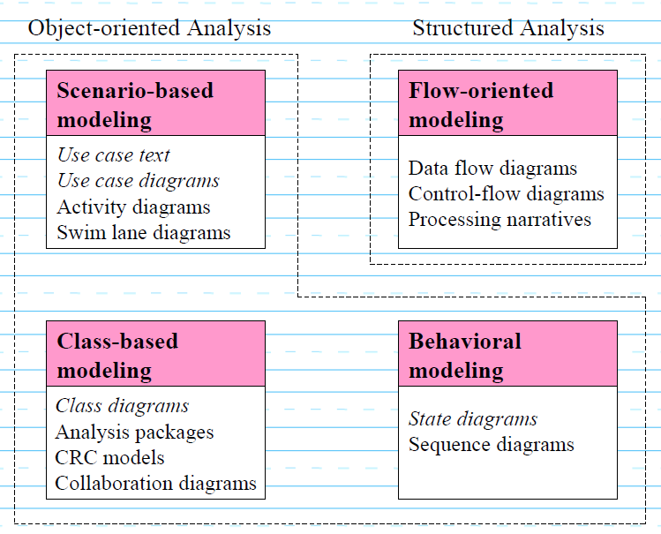
Elements of Analysis model
Flow-oriented modeling – provides an indication of how data objects are transformed by a set of processing functions
Scenario-based modeling – represents the system from the user's point of view
Class-based modeling – defines objects, attributes, and relationships
Behavioral modeling – depicts the states of the classes and the impact of events on these states
CRC-Class Responsibility Collaborator

Slide 55
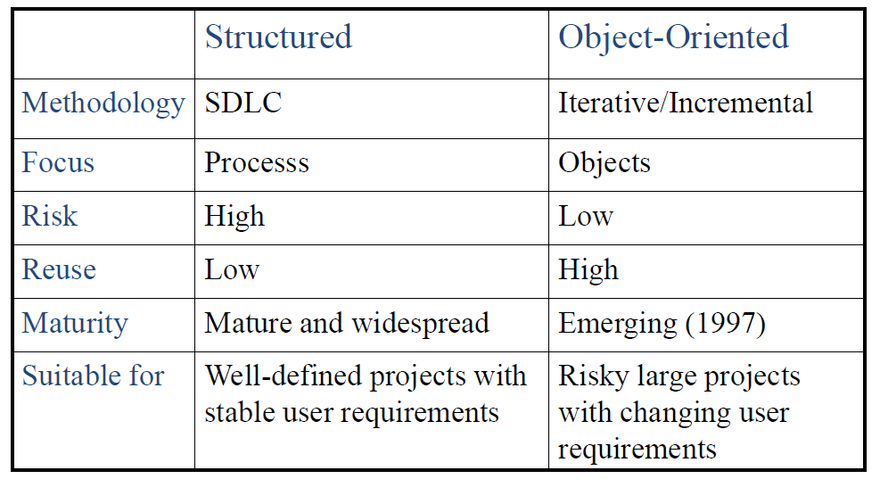
Structured vs OO analysis

Slide 56
